Slide 1
10x100 Transistor Model
Daniel Perodin

Slide 2
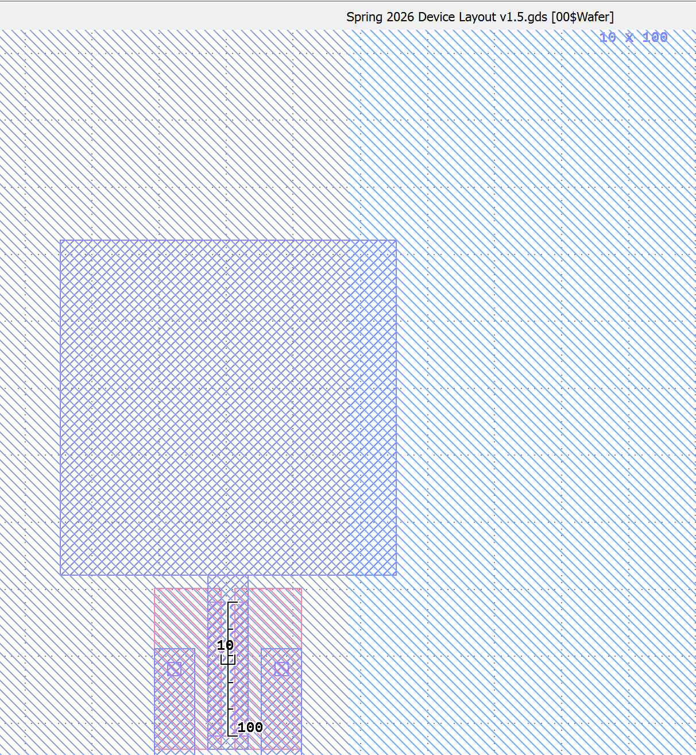
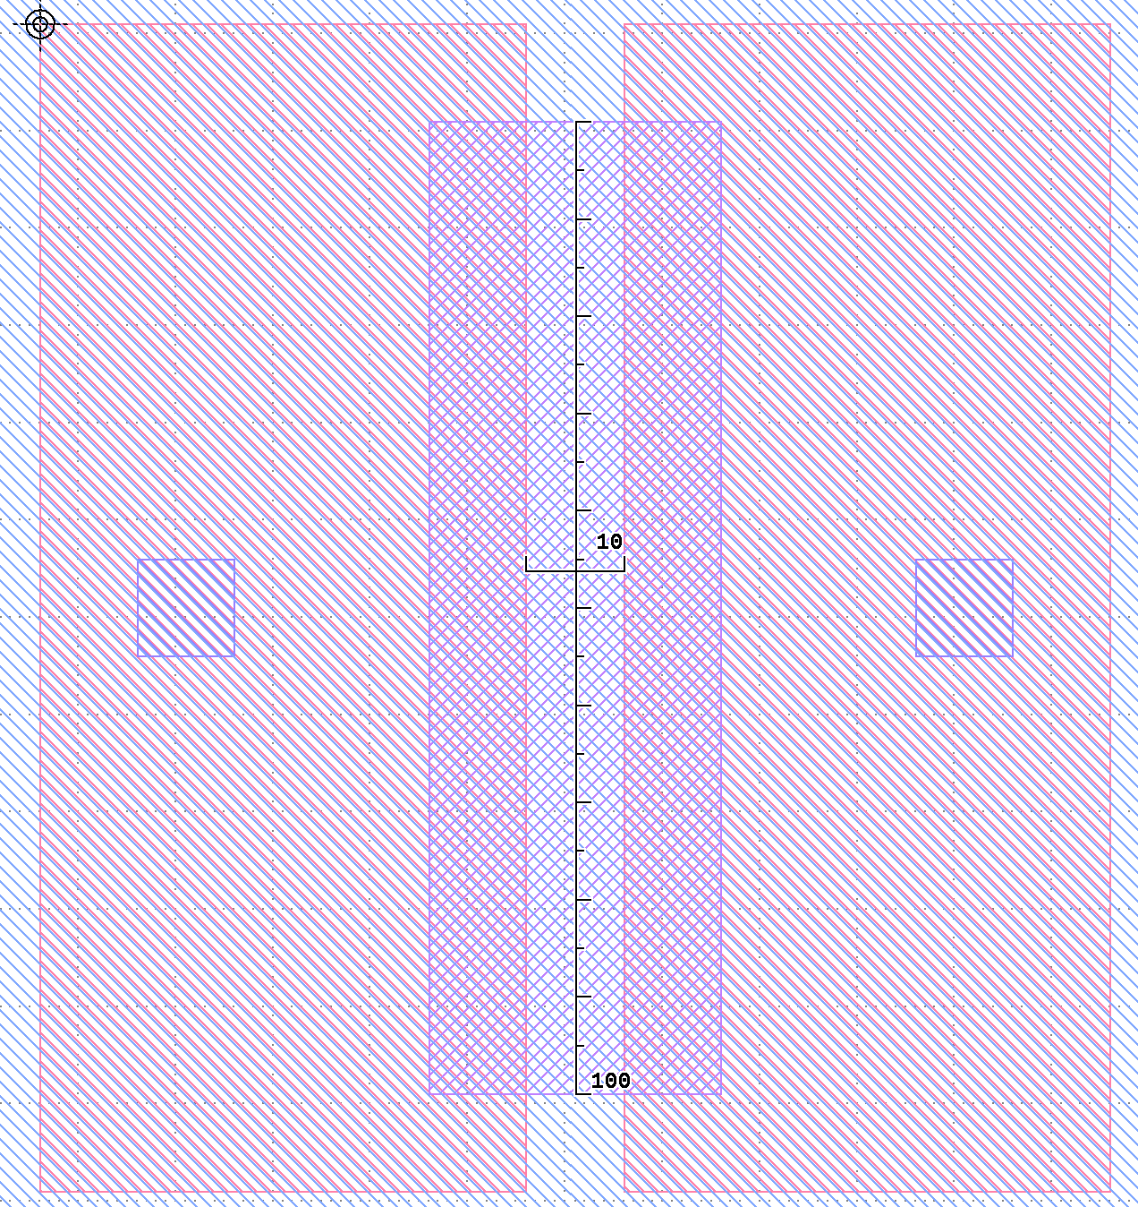
10x100 Transistor

Slide 3
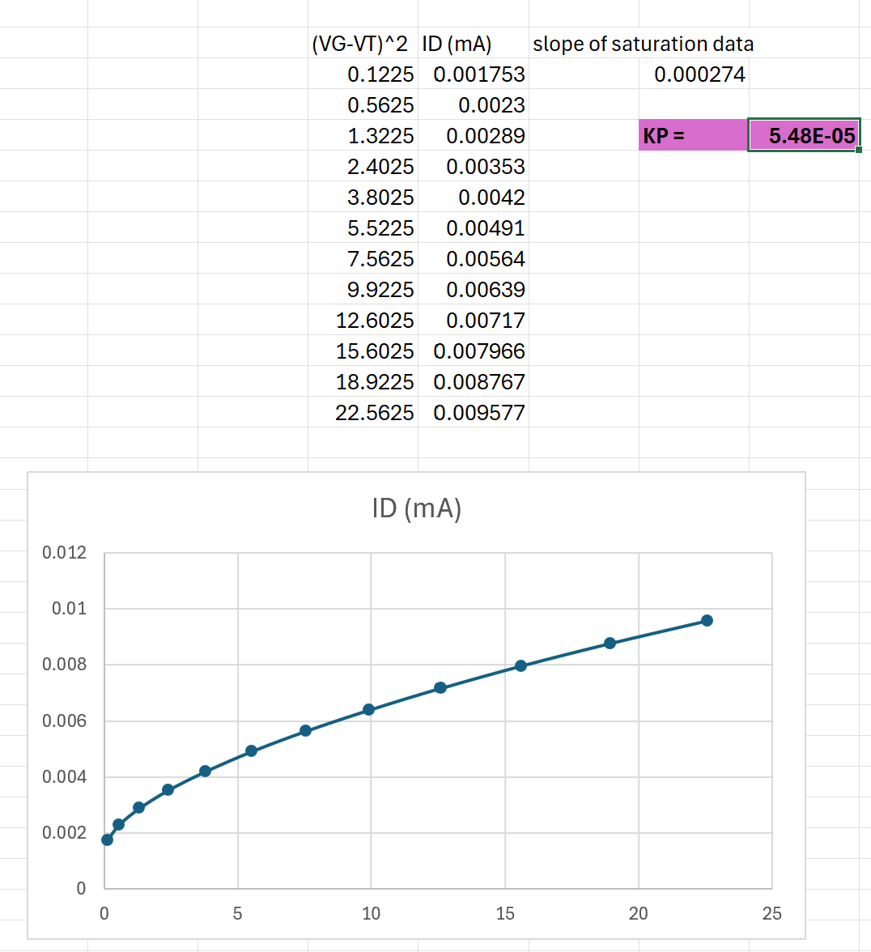
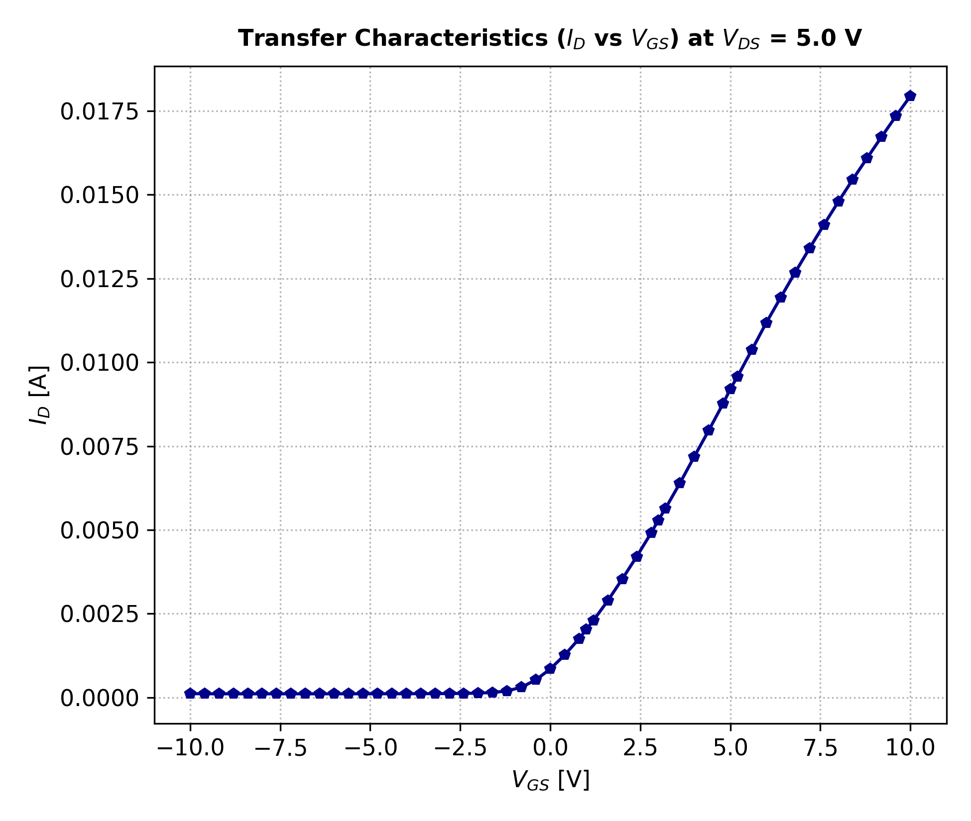
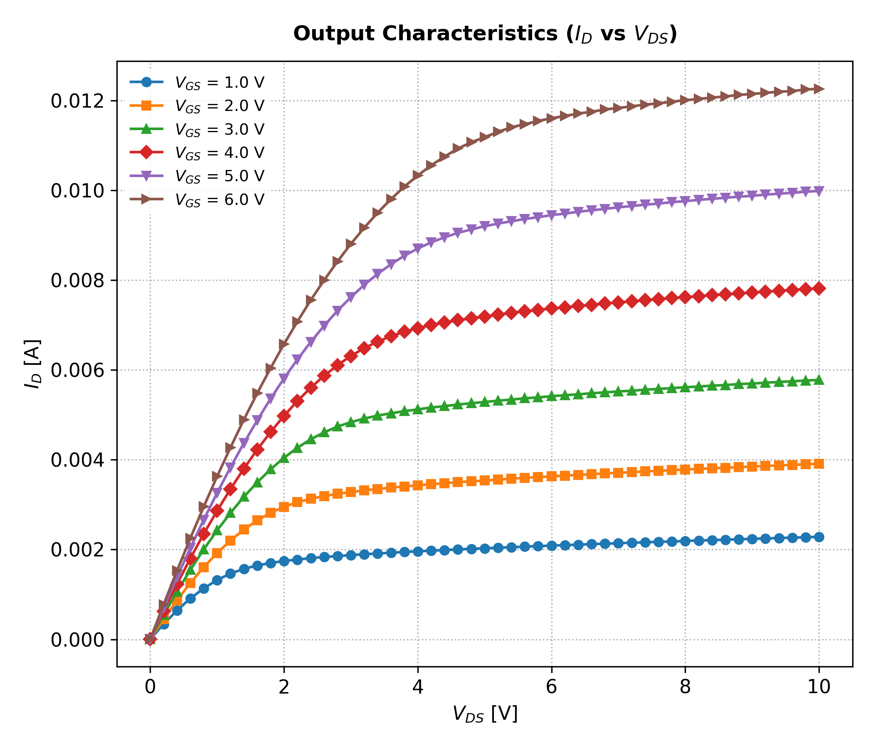
Constructing the Model
Parameter Calculation framework Credit: Nicolas Leeder
.model SCRO_NMOS NMOS(
LEVEL= 1
TOX= 4e-8
PHI= 0.614
GAMMA= 0.31
VTO= 0.45 V
KP= 54.8u
LAMBDA= 0.0226
)
LAMBDA:
At VGS = 1.0V
ID(5V VDS)
≈ 2.026 mA
ID(10V VDS)
≈ 2.284 mA
λ ≈ 0.0226 V^-1

Slide 4
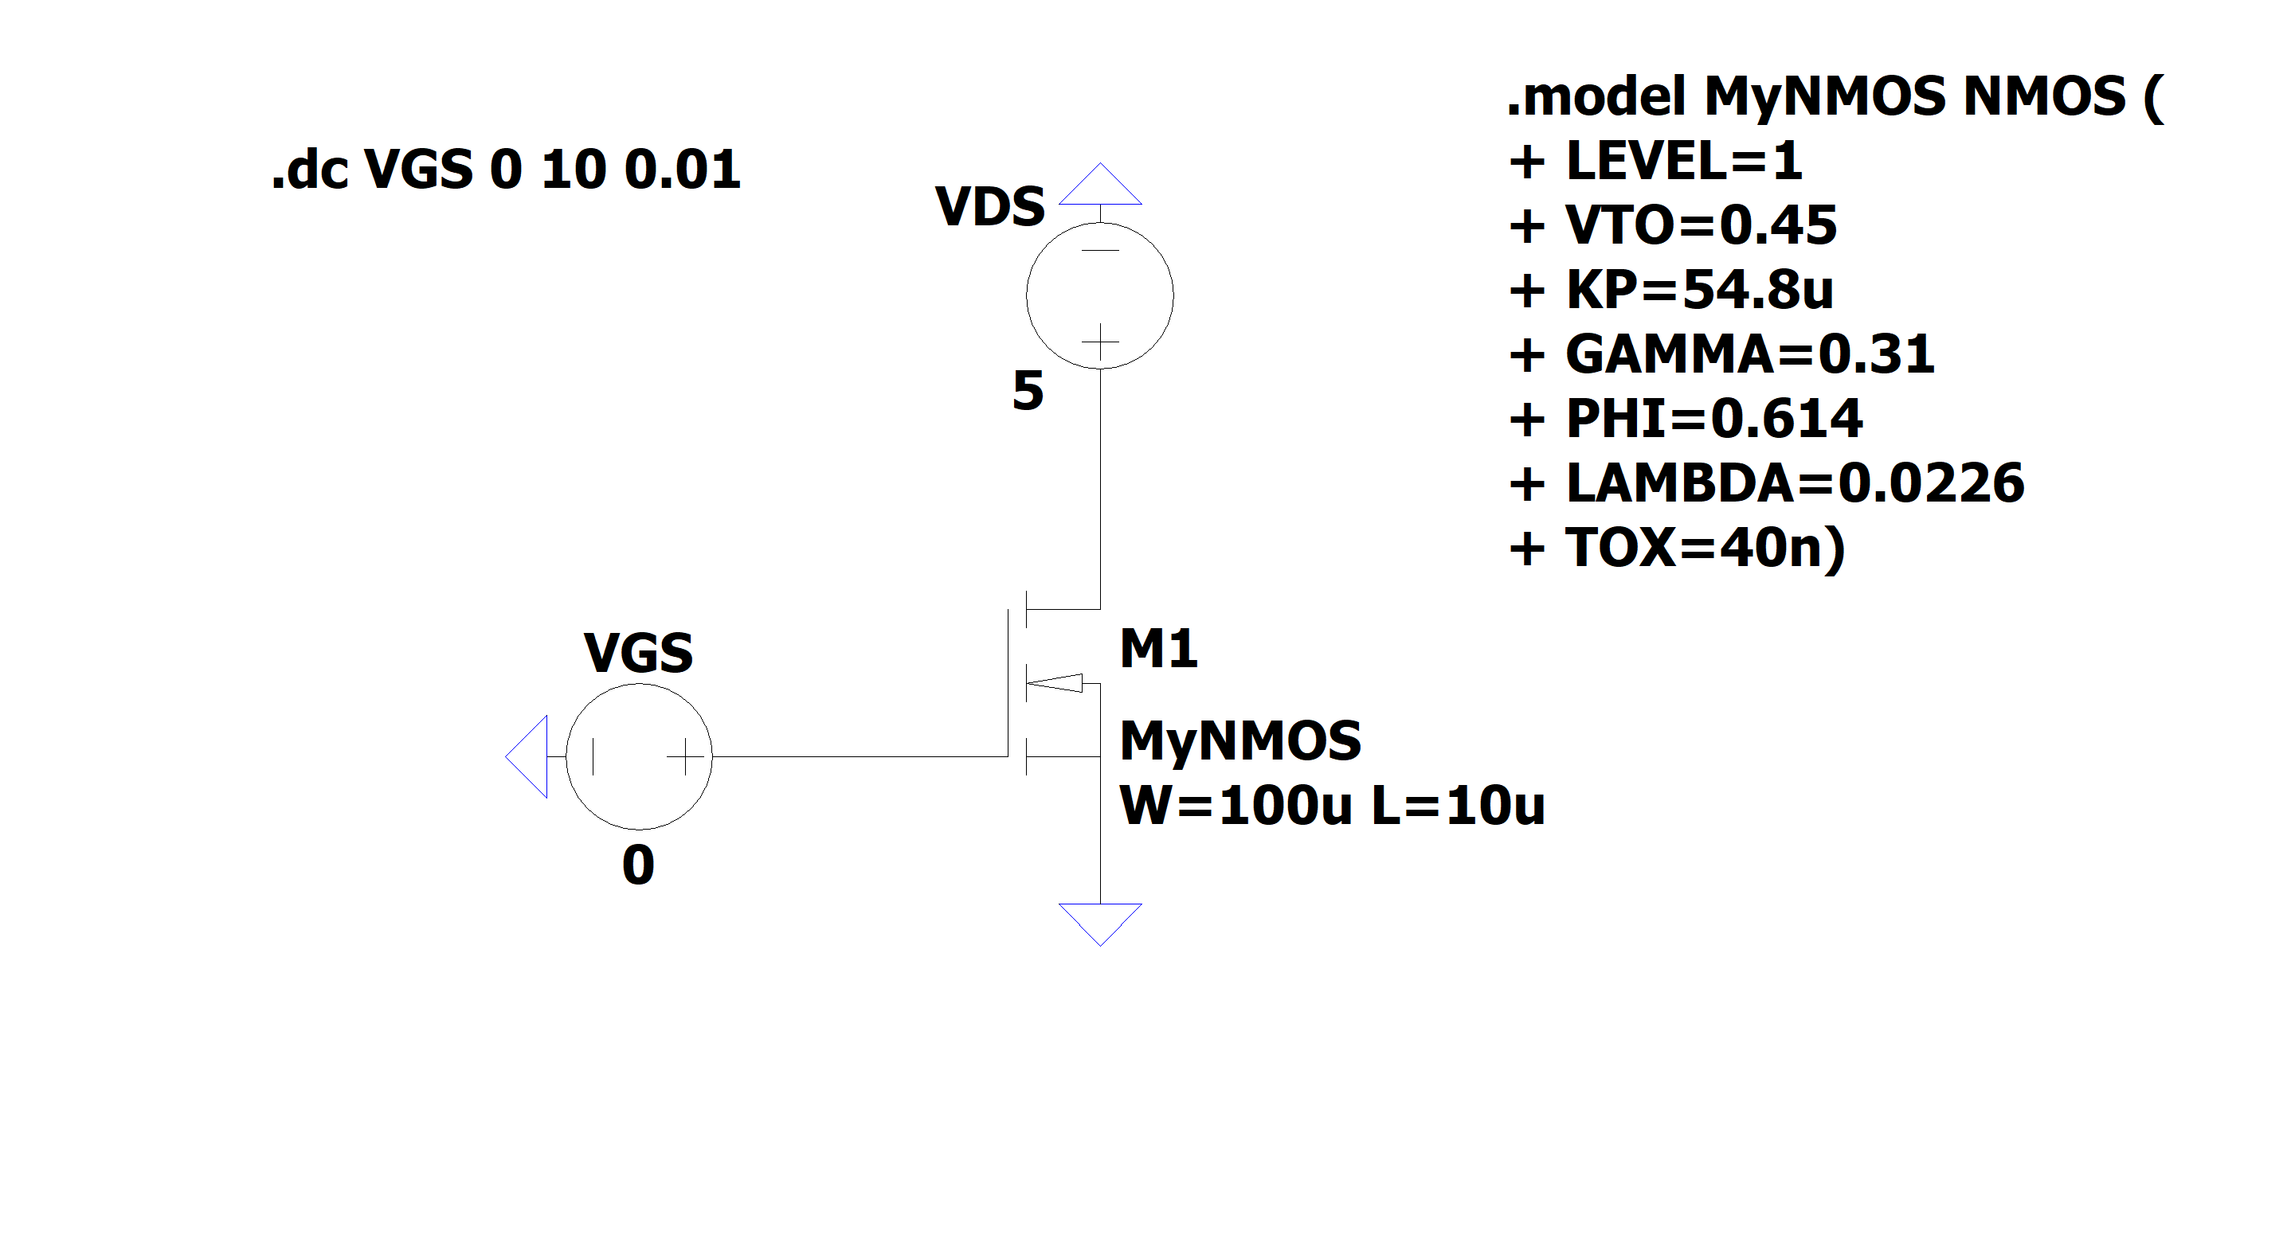
Testing the model (Ltspice)

Slide 5
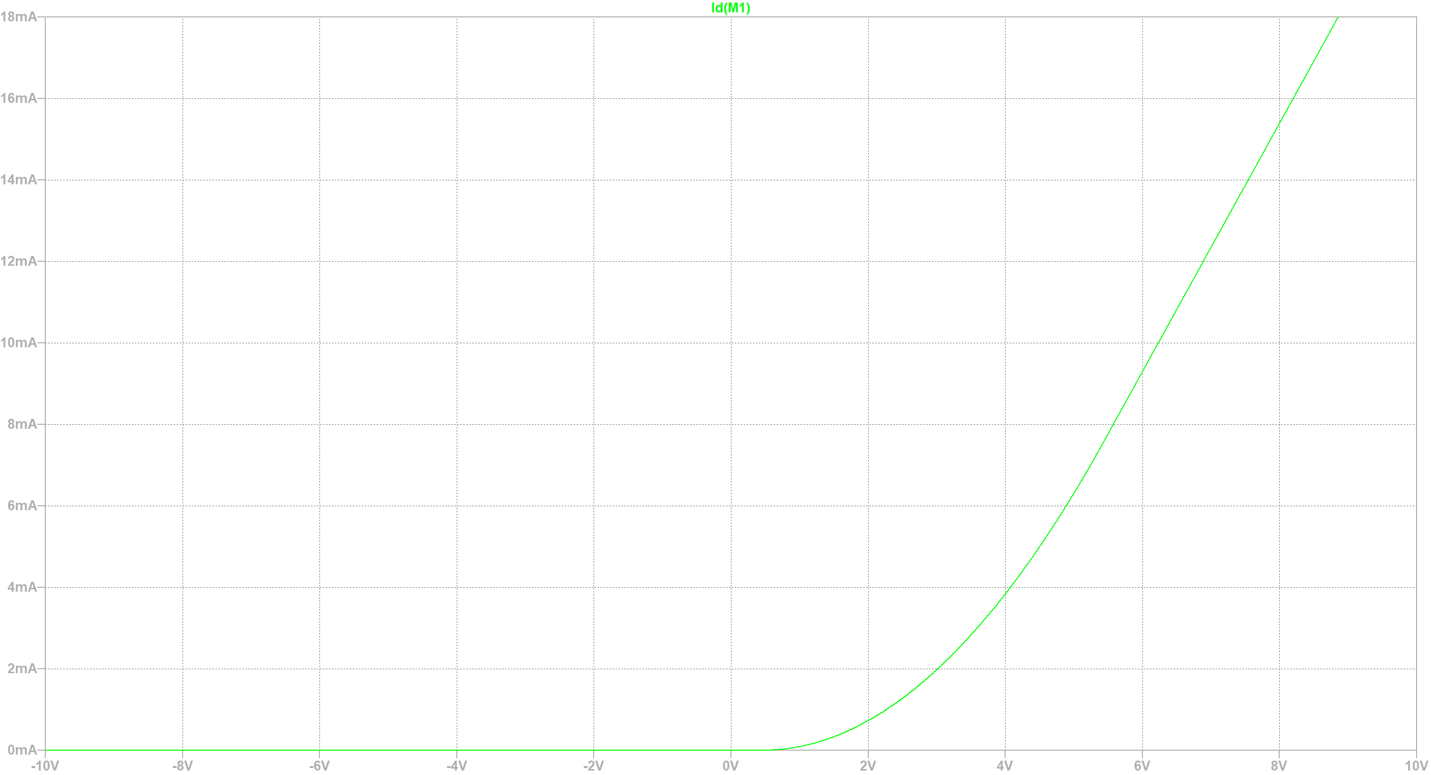
Testing the model (LTspice)
ID
VGS

Slide 6
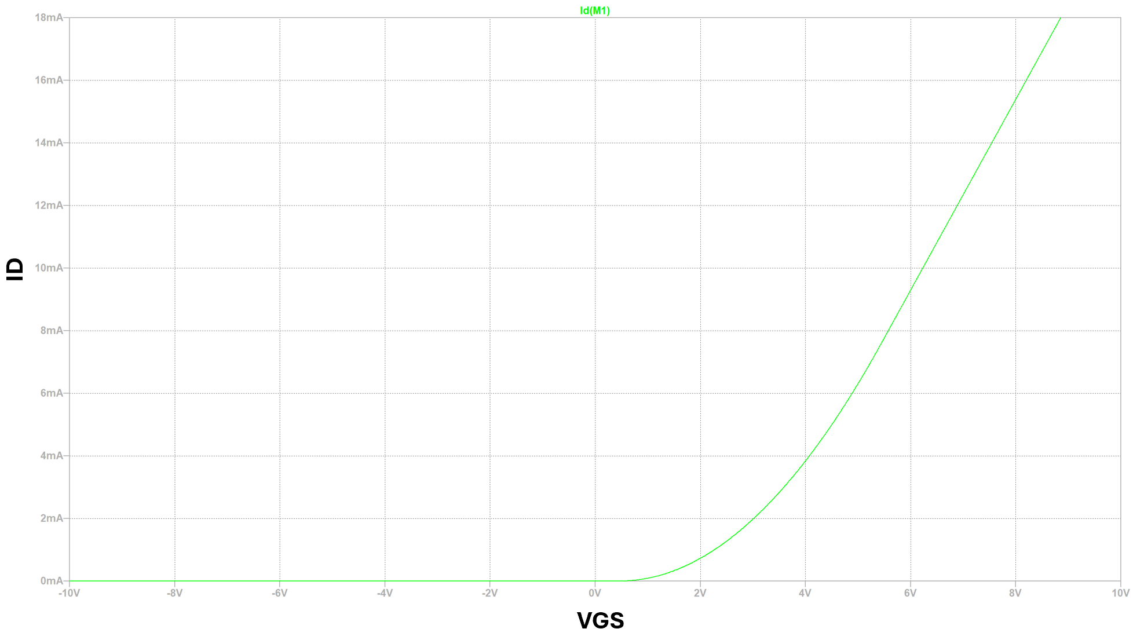

Slide 7
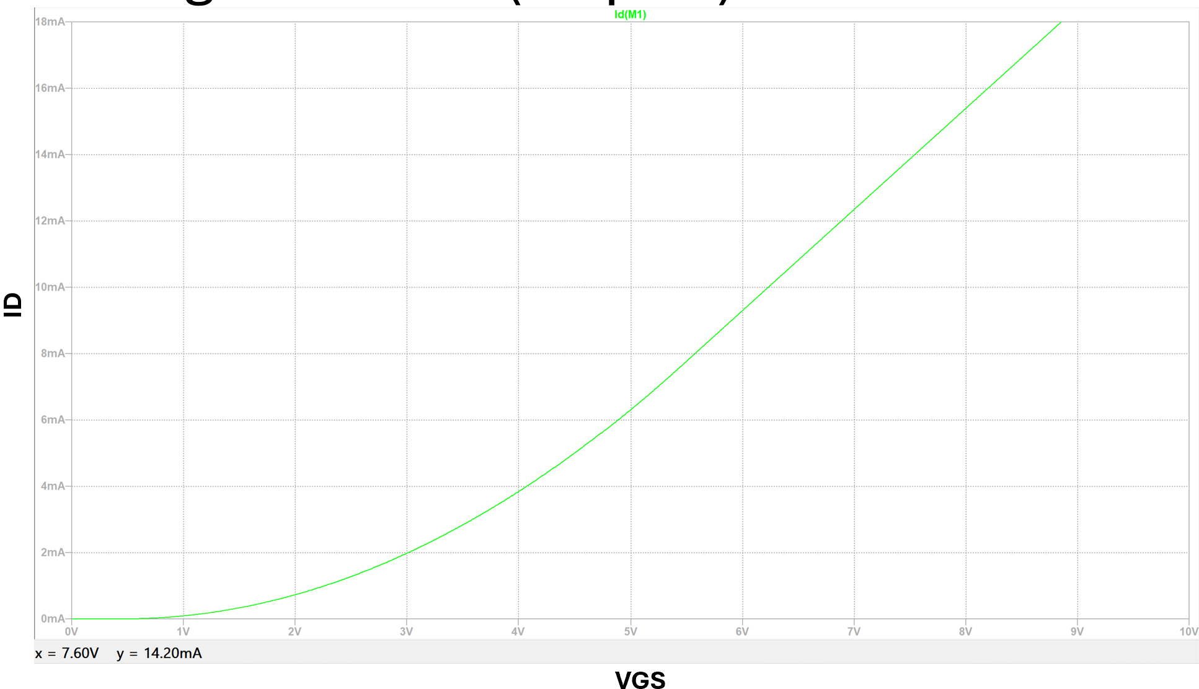

Looking at the recorded data from the fabricated transistors, the SPICE model is quite accurate for VGS between 7 V and 8 V, when VDS is kept at 5 V

Slide 8
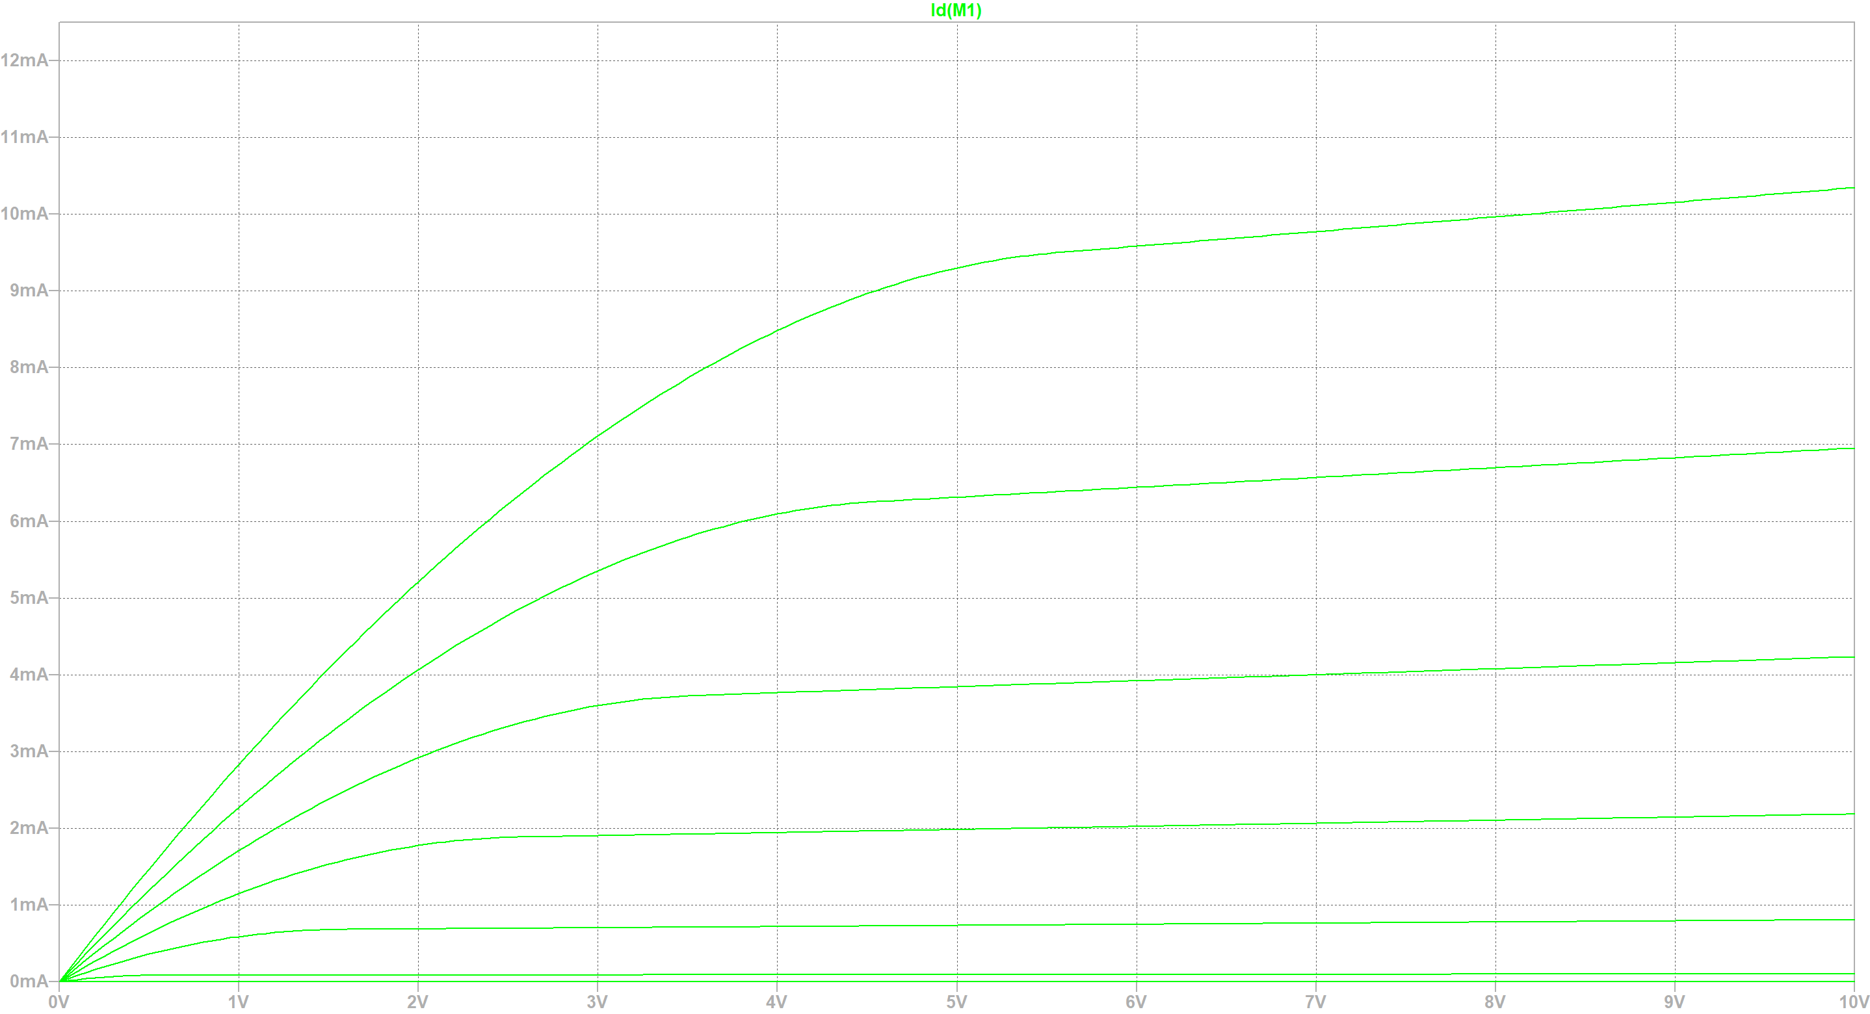
VGS = 6 V
VGS = 5 V
ID
VGS = 4 V
VGS = 3 V
VGS = 2 V
VGS = 1 V
VDS

Slide 9
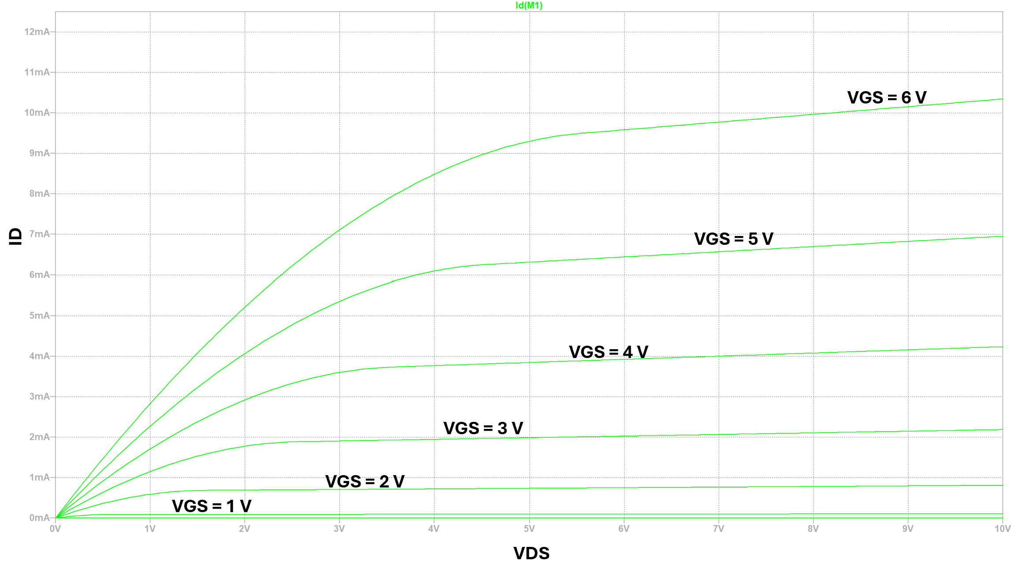

Slide 10
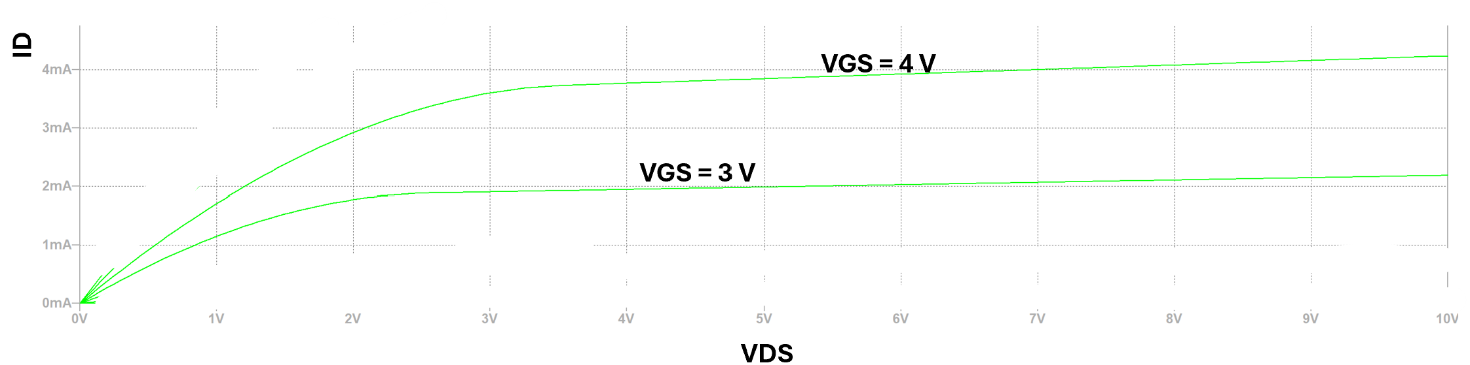
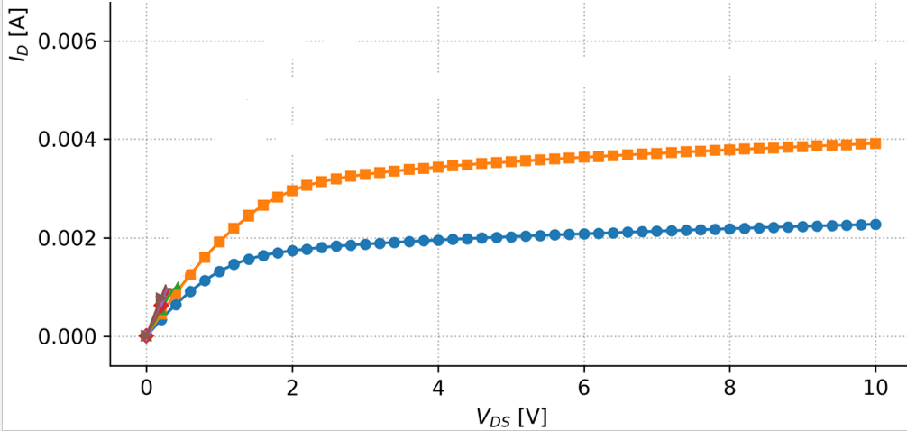



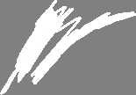

Slide 11

















